Slide 1
Welcome to Room 18
Mr. Schneider

Slide 2
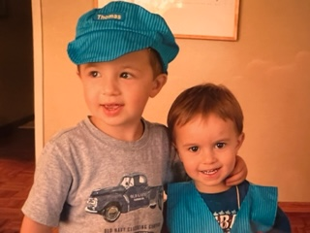

Slide 3

The beginning is here
Rays of hope

Slide 4
My Philosophy
You will learn
Empower Your Child
JUST TRY
PUT IN EFFORT
THIS IS THIRD GRADE
LEARN THE FUNDAMENTALS

Slide 5
My Philosophy/ Background
Family/Hobbies/Background
Independence/Effort
Calm
Joke around/At ease
Notes:
Tell about my family, gym, running, chicago

Slide 6
HIGHS MEDIUMS LOWS
HIGHS
Medium
Lows
Will not teach to any particular level
All are important

Slide 7

BENCHMARK ADVANCE IS NAME OF READING PROGRAM
NEW READING BENCHMARK ADVANCE SERIES
THEMES
Unit 1 Government and Citizenship
Unit 2 Character
Unit 3 Life Science
Unit 4 Point of View
Unit 5 Technology and Support
Unit 6 Theme
Unit 7 History and Culture
Unit 8 Earth Science
Unit 9 Economics
Unit 10 Physical Science
The new reading series will create readers who effectively make meaning, build knowledge, express understanding, and gain a solid foundation of literacy.
The themes of literacy instruction are content knowledge; A focused, careful mapping of knowledge strands, fueling a deeper understanding of content.
Meaning Making: The instructional heartbeat of the program. Here students will derive meaning from text.
Foundational Skills: The explicit and systematic instruction that lays the groundwork for literacy achievement.
Language Development
Effective Expression – create strong communicators

Slide 8


Slide 9
HOMEWORK/STRESS FREE
EFFORT IS KEY
Homework is daily (not Friday)
Students write down homework
Homework is due the next day
We can modify your child’s homework
HOMEWORK IS 30 MINUTES
I keep track using the dot method

Slide 10

Writing Program
Narrative
Descriptive
Expository/Opinion
Inform
Research

Slide 11
Math Program
Website is THINK CENTRAL
Common Core workbook
Math Homework/Remembering
Chapter pacing
Whole class-Practice skills-independent
YOU CAN ACCESS THE MATH BOOK
AND MATH HOMEWORK BOOK ON CLEVER

Slide 12
HISTORY PROGRAM
FUSD HISTORY PROGRAM
THE NAME OF THE HISTORY PROGRAM IS CALLED…
SOCIAL STUDIES ALIVE!
CALIFORNIA COMMUNITIES
Understanding Geography of the World
Finding Places in California
Geography and the Way We Live
American Indians in California
Settling in California
Making Communities Better
Government in the United States
Citizens and Participation
Protecting the Environment
Economy, Choices in a Free Market, Using Money

Slide 13
How do you know when there’s a test?
Friday -Reading test (Benchmark)
Thursday – Spelling test
Math-end of every chapter/ practice test-quizzes
in between
Science/History tests-Fridays

Slide 14
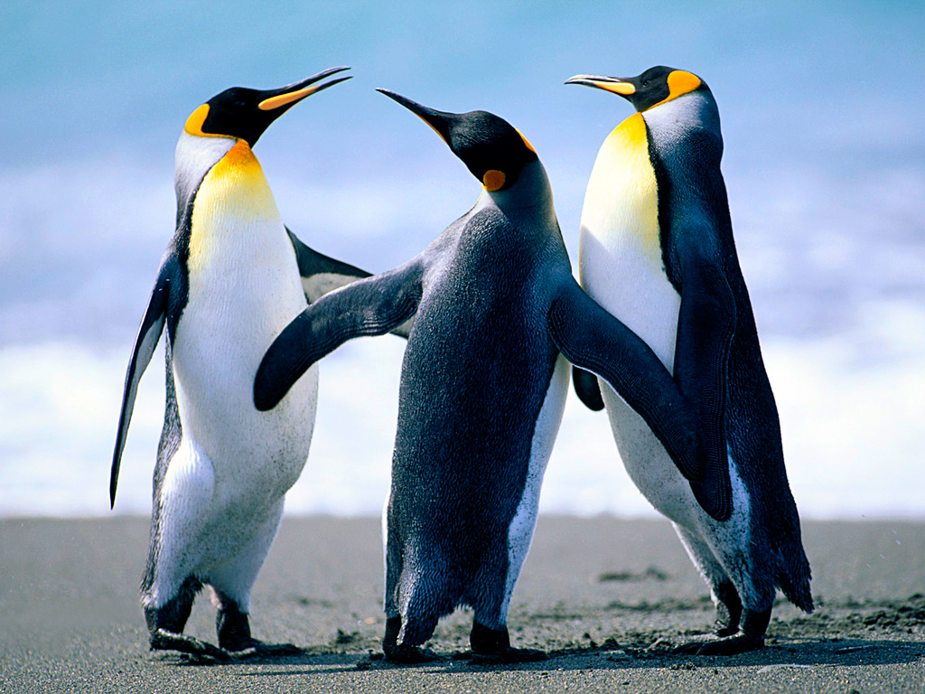
Extra PE (Cal 200)
100 minutes per week

Slide 15

GOOGLE CLASSROOM
CHROME BOOKS
GOOGLE CLASSROOM (PARENTS SET UP)
This Photo by Unknown Author is licensed under CC BY

Slide 16
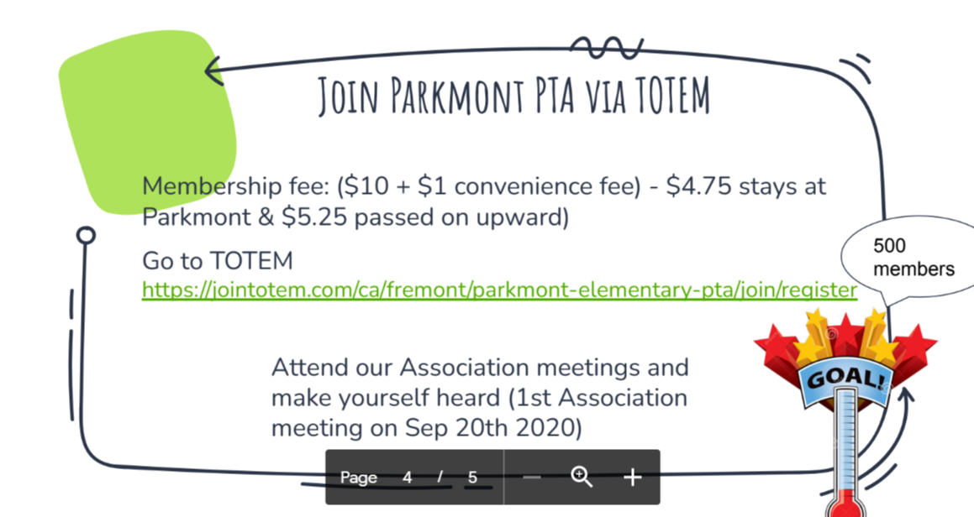

Slide 17
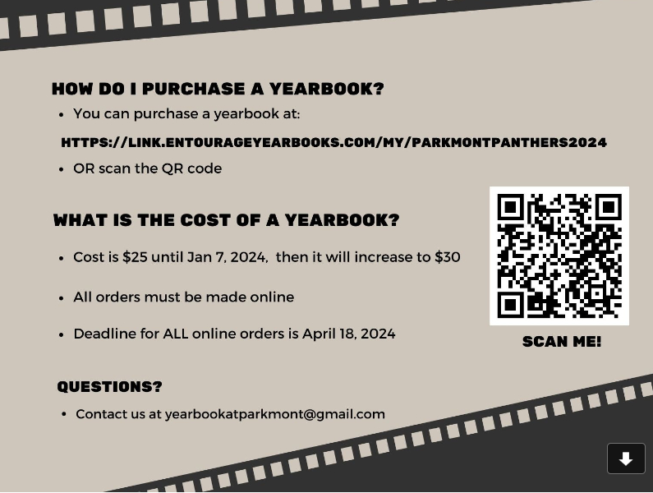

Slide 18
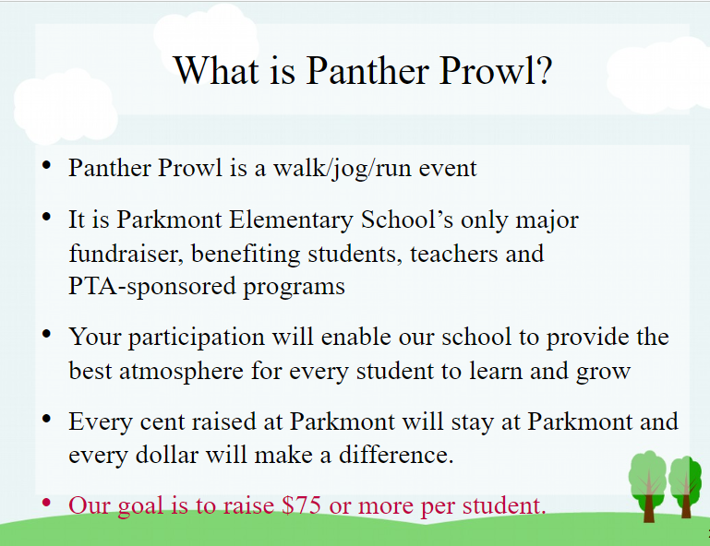

Slide 19
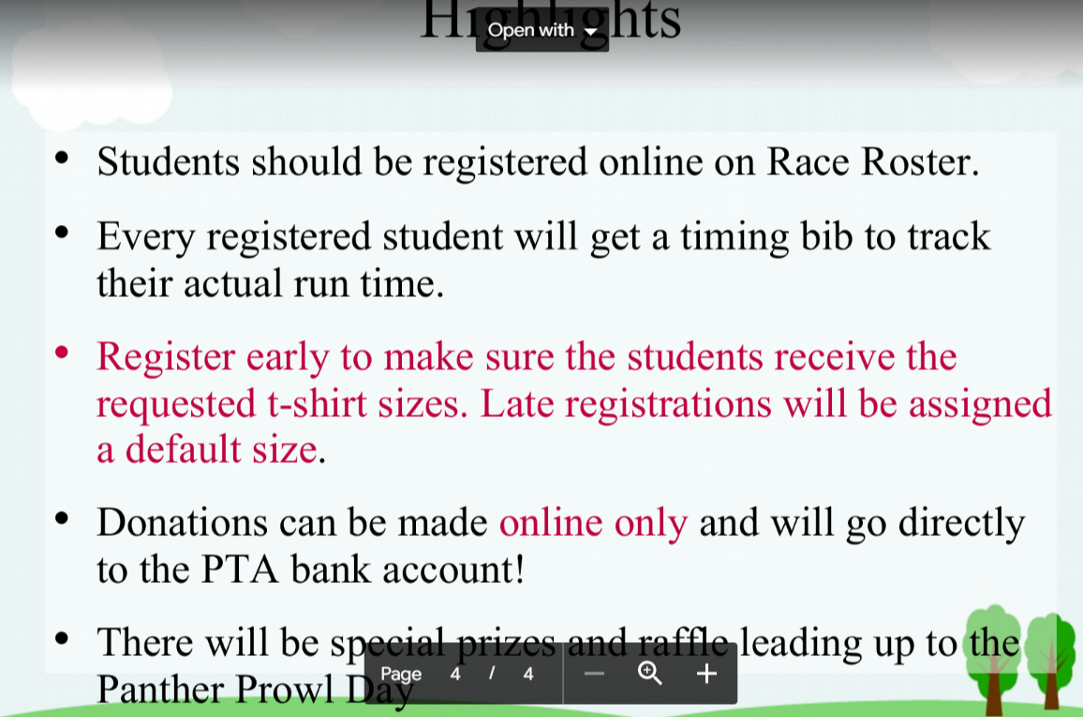

Slide 20
Panther Prowl-Donations
Goal is $75.00 per child (online)
Folders
Art supplies
School Bus
Ink Cartridges
Pizza Parties
Auction Prizes
Workbooks
Software
Notebooks
Labels
Film developing
Manipulative
Batteries
tape

Slide 21
REPORT CARDS
STANDARD BASED GRADING USING 1,2,3,4
I NORMALLY DO NOT GIVE OUT FOURS IN ACADEMICS UNTIL THE THIRD TRIMESTER

Slide 22
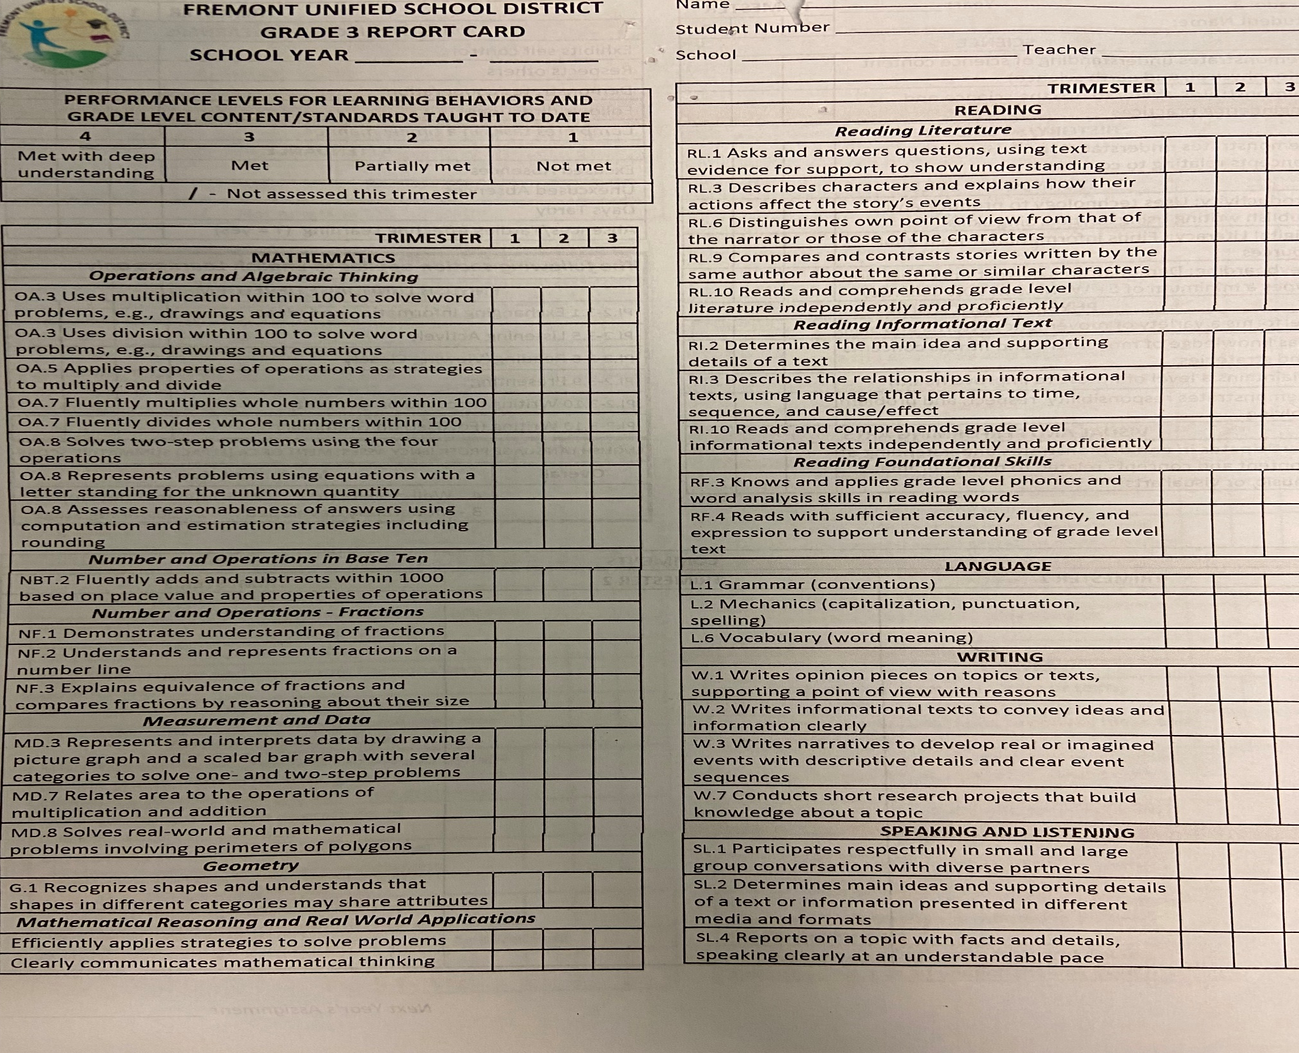

Slide 23
FIELD TRIPS
Volunteers
Tule Ponds
Coyote Hills
Blackhawk Museum
STILL NEED PERMISSION

Slide 24
INDEPENDENT STUDY RULES
1 Independent Study granted for elementary
Give at least ten days notice to OFFICE
All work given to student must be completed and turned in on day of return.

Slide 25
Absences
CONTACT THE OFFICE FOR ALL ABSENCES
CONTACT THE OFFICE FOR EARLY PICKUPS
SIGN IN WHEN VISITING
CONTACT THE OFFICE FOR ALL INDEPENDENT STUDIES

Slide 26
Extra Credit
Bring in any material from home
Buy workbooks
Bring in books
Students can use worksheets/books I provide
Packets given out monthly

Slide 27

RESOURCE PROGRAM
RESOURCE PROGRAM/SPEECH

Slide 28
FOOD POLICY
ALL food must be store bought for parties
Students may not share food
No food items for birthdays

Slide 29
Volunteers – Room Parent
Putting material together
Language help
Field trips
Art/culture/music
Parties
Room Parent

Slide 30
Other fun activities
Friday Fun
Buddy Class with 5th grade
Plays
Pizza Parties
Holiday Parties
Recital

Slide 31
PLEASE FILL OUT THE PARENT QUESTIONNAIRE
PLEASE RETURN THE MOVIE/LIBRARY PERMISSION SLIP FORM.
SCHOLASTIC BOOK ORDERS WILL BE SENT OUT ONCE PER
MONTH. ALL BOOK ORDERS WILL BE ONLINE. I WILL SEND OUT INFORMATION ON HOW TO PLACE A BOOK ORDER.
Parent Questionnaire
Movie Form
Book Order

Slide 32
MY NEWSLETTER
Please look over my weekly newsletter!
Click on the link below my name
Mr. Schneider
https://schneidercats.wixsite.com/mysite

Slide 33
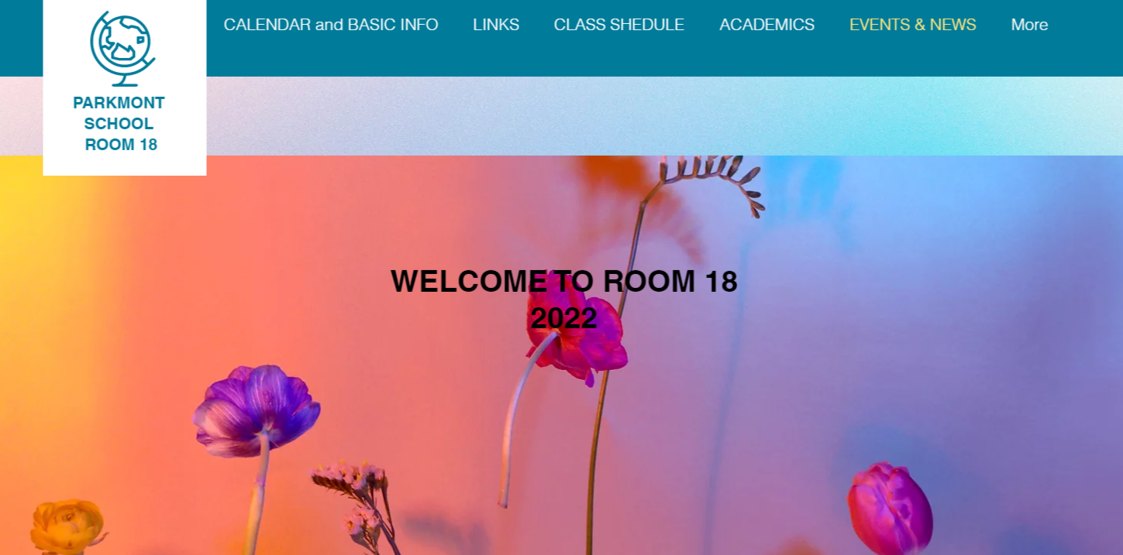
24

Slide 34
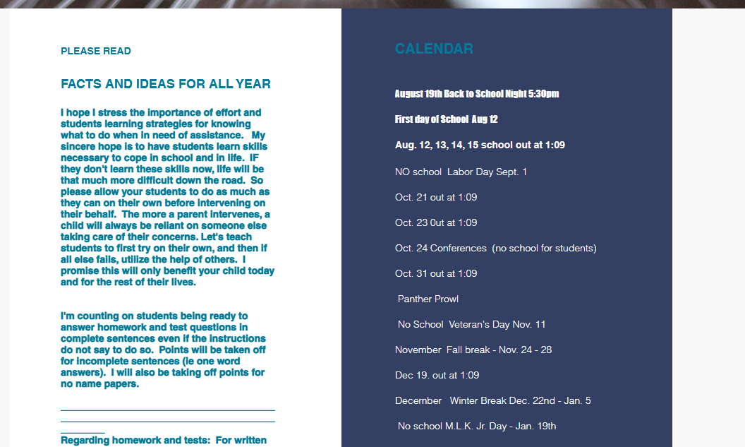

Slide 35

Discipline
WORK WITH THE TEACHER. LET’S COME UP WITH A PLAN.
This Photo by Unknown Author is licensed under CC BY-SA

Slide 36
School is from 8:10-2:15
If a student is late, get a tardy slip from office
Every Wednesday school ends at 1:09
​
MON SCIENCE 12:15 – 12:45
MON PE 10:45 – 11:30
TUE PE 11:00 – 11:30
WED SCIENCE 8:40 – 9:10​
THUR. COMPUTERS 1:45 – 2:15
FRI COMPUTERS 8:10 – 8:40
FRI LIBRARY 10:00 – 10:30
LUNCH IS 11:35 - 12:15 everyday
​
Recess 9:40 – 9:55 everyday and 1:20 - 1:30

Slide 37
WISH LIST
Sharpened pencils
Hand Sanitizer
Washable Markers
Incentive Gifts
Glue Sticks

Slide 38

SCHOLASTIC BOOK ORDERS

Slide 39

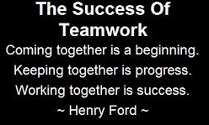
WORK TOGETHER 50-50
Come to me first with any problems
Encourage your child to come to me first
We can make arrangements to make things work

Slide 40
EFFORT over GRADE
Too late if you wait

Slide 41
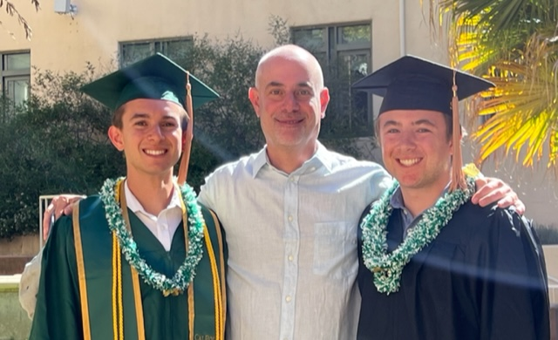

Slide 42

To contact me
CONCERNS
PLEASE EMPOWER YOUR CHILD TO TALK WITH ME
793-7492 x66018

Slide 43

Notes:
PLAY VIDEO

Slide 44

Have Patience
Let’s work together for a great year!!!!!!!!!!!!!!!!!!

Slide 45

THANKS FOR ATTENDING
PLEASE SEND ME AN EMAIL
FOR ANY QUESTIONS OR CONCERNS.

